Slide 1
COPADS
#3 – Multithreading Basics
IFEOLUWATAYO IGE, 2023

Slide 2
OUTLINE
Processes & Threads
Deadlock
Inter-Process Communication
C# and Threads

Slide 3
Processes and Threads
A thread is an independent execution path that can run simultaneously with other threads.
Threads are independent- which means if an exception occurs in one thread, it doesn't affect other threads
Multithreading –Technique that concurrent (simultaneous) execution of two or more parts of a program (threads) for maximum CPU utilization.
A process is a group (1 or more) of threads that share a set of resources
Each thread has an ID, program counter, instruction Register, etc.

Slide 4
Resource Sharing among Threads
https://www.math.stonybrook.edu/~ccc/dfc/dfc/signals.html
Single Threaded Process Vs Multithreaded Process
Notes:
https://www.math.stonybrook.edu/~ccc/dfc/dfc/signals.html

Slide 5
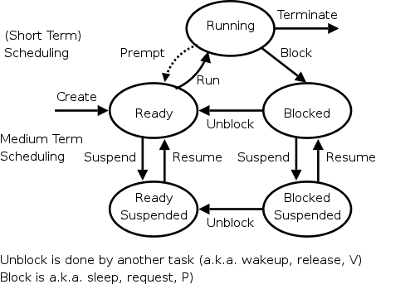
Thread State Diagram
Ready: waiting to be executed
Running: being executed by the processor
Ready-Suspended: in secondary memory due to lack of space in main memory
Blocked: resource unavailable, waiting for some event to occur. E.g. I/O
Blocked-Suspended: are in secondary memory. Was initially in the blocked state in the main memory but due to limited space was moved
Preempt: The “ejected” thread may not need any resources. Probably the turn of another thread to run on the processor (time slice). The ejected thread will only wait for another turn on the processor

Slide 6
Single Threaded versus Multithreaded Processes
The Word Processor (Multithreaded)
Interaction thread with the user via keyboard
Reformatting thread to reformat the whole document if deletion is done
Thread that helps to autosave the entire file to disk every few minutes
If it is a single-threaded,
Whenever a disk backup started, commands from the keyboard and mouse would be ignored until the backup was finished. A very slow response is expected during this period.
Having three separate processes is impossible because all three threads must operate on the same document.
The threads share a common memory and so have access to the same document being edited

Slide 7
Thread Scheduling
On a single processor machine, the scheduler just picks a new item from the queue and assigns it to the processor
When the allotted time is exceeded (for instance if a round-robin algorithm is used), it is preempted.
On a multiprocessor system, the scheduler assigns the top threads from the thread queue to run if multiple cores are available.
The cores share a ready queue so that a thread doesn’t always have to select which processor to run on
This also means that 2 threads from the same process may run at the same time

Slide 8
Thread coordination
Although threads can communicate with sibling threads, there may be a need to restrict access to shared resources. Hence the need for LOCKS.
Locks are used for achieving exclusive access to shared data.
A thread acquires a lock to a resource when it is assigned the resource.
Acquiring a lock allows a thread to have exclusive access to the data or resource guarded by that lock, forcing other threads to a block state if those threads are also trying to acquire that same lock.
There is therefore a need to be careful while assigning locks to avoid deadlocks
Notes:
If two threads are updating a bank account balance at the same time, we should put a lock on that section

Slide 9
Deadlocks
A Deadlock occurs when two (or more) threads are trying to access a resource locked by another thread, and neither can proceed.
Scenario: Thread A has resource M locked and wants resource K
Thread B has resource K locked, and wants resource M
There is a need to use caution when writing multithreaded programs
Deadlocks rarely occur but;
When they do, they are extremely difficult to track down and may be quite challenging to fix
Notes:
Draw the traffic left turn issue

Slide 10
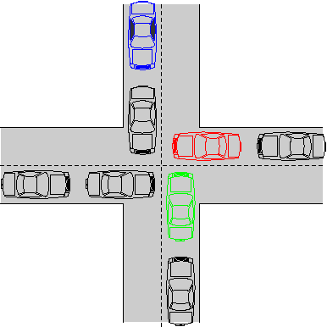
Deadlocks
The road is the resource – only one car can occupy a space of pavement at a time
Red car is blocked by the car in front (and can’t move)
Green car is blocked by Red Car
Blue car prevents the one in front from backing up
No cars can move
Red car can turn right, but what if the top and right roads were one-way?
Will revisit solutions to deadlocks in the coming weeks, including more details on the causes and solutions

Slide 11
Inter-Process Communication
Shared Resources, files in Memory
Remote Procedure Call
Network Protocols

Slide 12
Shared Resources, Files in Memory
Mutual Exclusion/Lock
A Process may lock a resource while in use
Semaphores-signal mechanism. A variable that indicates the availability of a resource or not depending on its value (count).
The resources could be printers, multiple memory buffers, etc.
This mechanism restricts the number of simultaneous users of these resources up to a maximum number.
A process may request access to the resource and be assigned (decrementing the semaphore). When the process releases the resource, it gives a signal which increments the semaphore.
Scenario: Many bathrooms with identical Keys, incremented or decremented semaphore when users take or return keys.

Slide 13
IPC – Remote Procedure Call
Ability to run a function on another (or local) computer as if it were local
Also called Remote Method Invocation (RMI)when used in an object-oriented application
This involves writing object-oriented programming in which objects on different computers can interact in a distributed network.
Allows calling of methods on remote objects
Example is online e-commerce applications

Slide 14
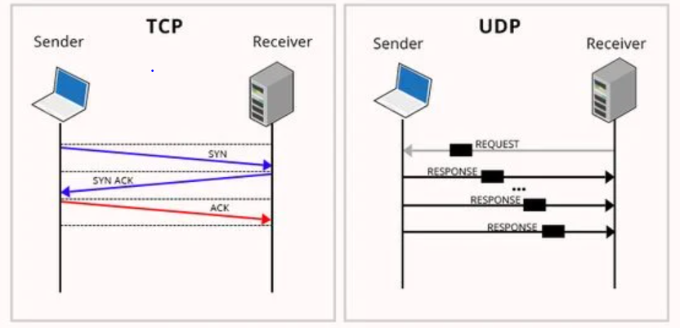
IPC - Networking Protocols
Processes send distributed messages to multiple receivers via Networking protocols
Two key networking protocols (WEEK 6)
TCP (Transmission Control Protocol) – using streams, reliable (error detection via checksum), slower
UDP (User Datagram Protocol) – using Datagrams, unreliable, faster
Notes:
https://www.colocationamerica.com/blog/tcp-ip-vs-udp
https://stackoverflow.com/questions/17446491/tcp-stream-vs-udp-message#:~:text=TCP%20is%20a%20connection%2Doriented,between%20to%20ends%20during%20transfer.

